Slide 1

Introduction to Operating Systems CS/COE 1550
Fall 2021
Sherif Khattab
ksm73@pitt.edu
(Some slides are from Silberschatz, Galvin and Gagne ©2013)

Slide 2
Announcements
Upcoming deadlines:
Homework 11: Friday 12/3
Project 4: 12/20 at 5:00 pm
Please check Canvas for the rest of the deadlines
Bonus opportunities
Bonus homework
Post-course test
OMET bonus (response rate >= 80%)

Slide 3
Unix Fast File System indexing scheme
protection mode
data
owner & group
data
.
.
.
timestamps
size
data
block count
•
data
•
.
.
.
link count
•
Direct pointers
.
.
.
data
•
•
•
data
•
.
.
.
•
•
single indirect
•
•
data
double indirect
•
•
data
•
•
•
•
.
.
.
triple indirect
•
•
•
inode
•
•
•
data

Slide 4
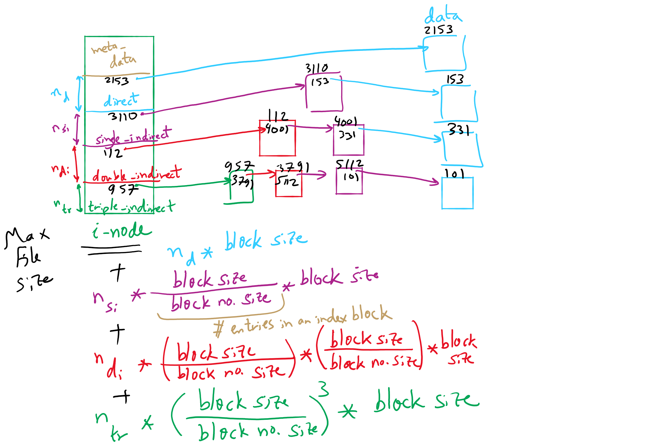
FFS and Max File Size

Slide 5
What’s in a directory?
Two types of information
File names
File metadata (size, timestamps, etc.)
Basic choices for directory information
Store all information in directory
Fixed size entries
Disk addresses and attributes in directory entry
Store names & pointers to index nodes (i-nodes)
attributes
games
attributes
games
mail
attributes
mail
attributes
news
attributes
news
attributes
research
attributes
research
Storing all information in the directory
Using pointers to index nodes
attributes

Slide 6
Free Block Tracking
10

Slide 7
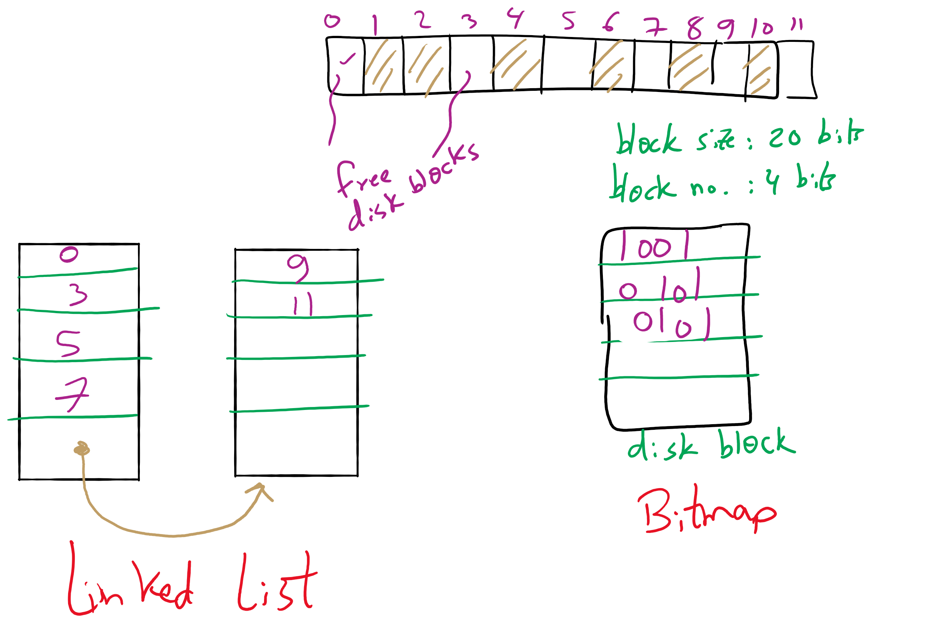
Free Block Tracking Example

Slide 8
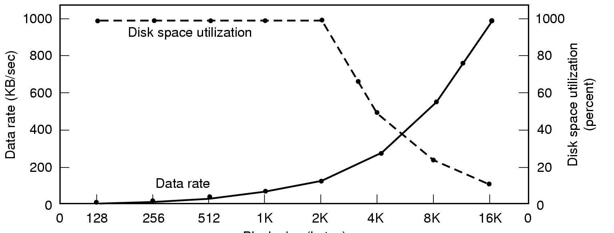
Disk block size
Dark line (left hand scale) gives data rate of a disk
Dotted line (right hand scale) gives disk space efficiency
All files 2KB
Block size

Slide 9

Project 4 Hint

Slide 10
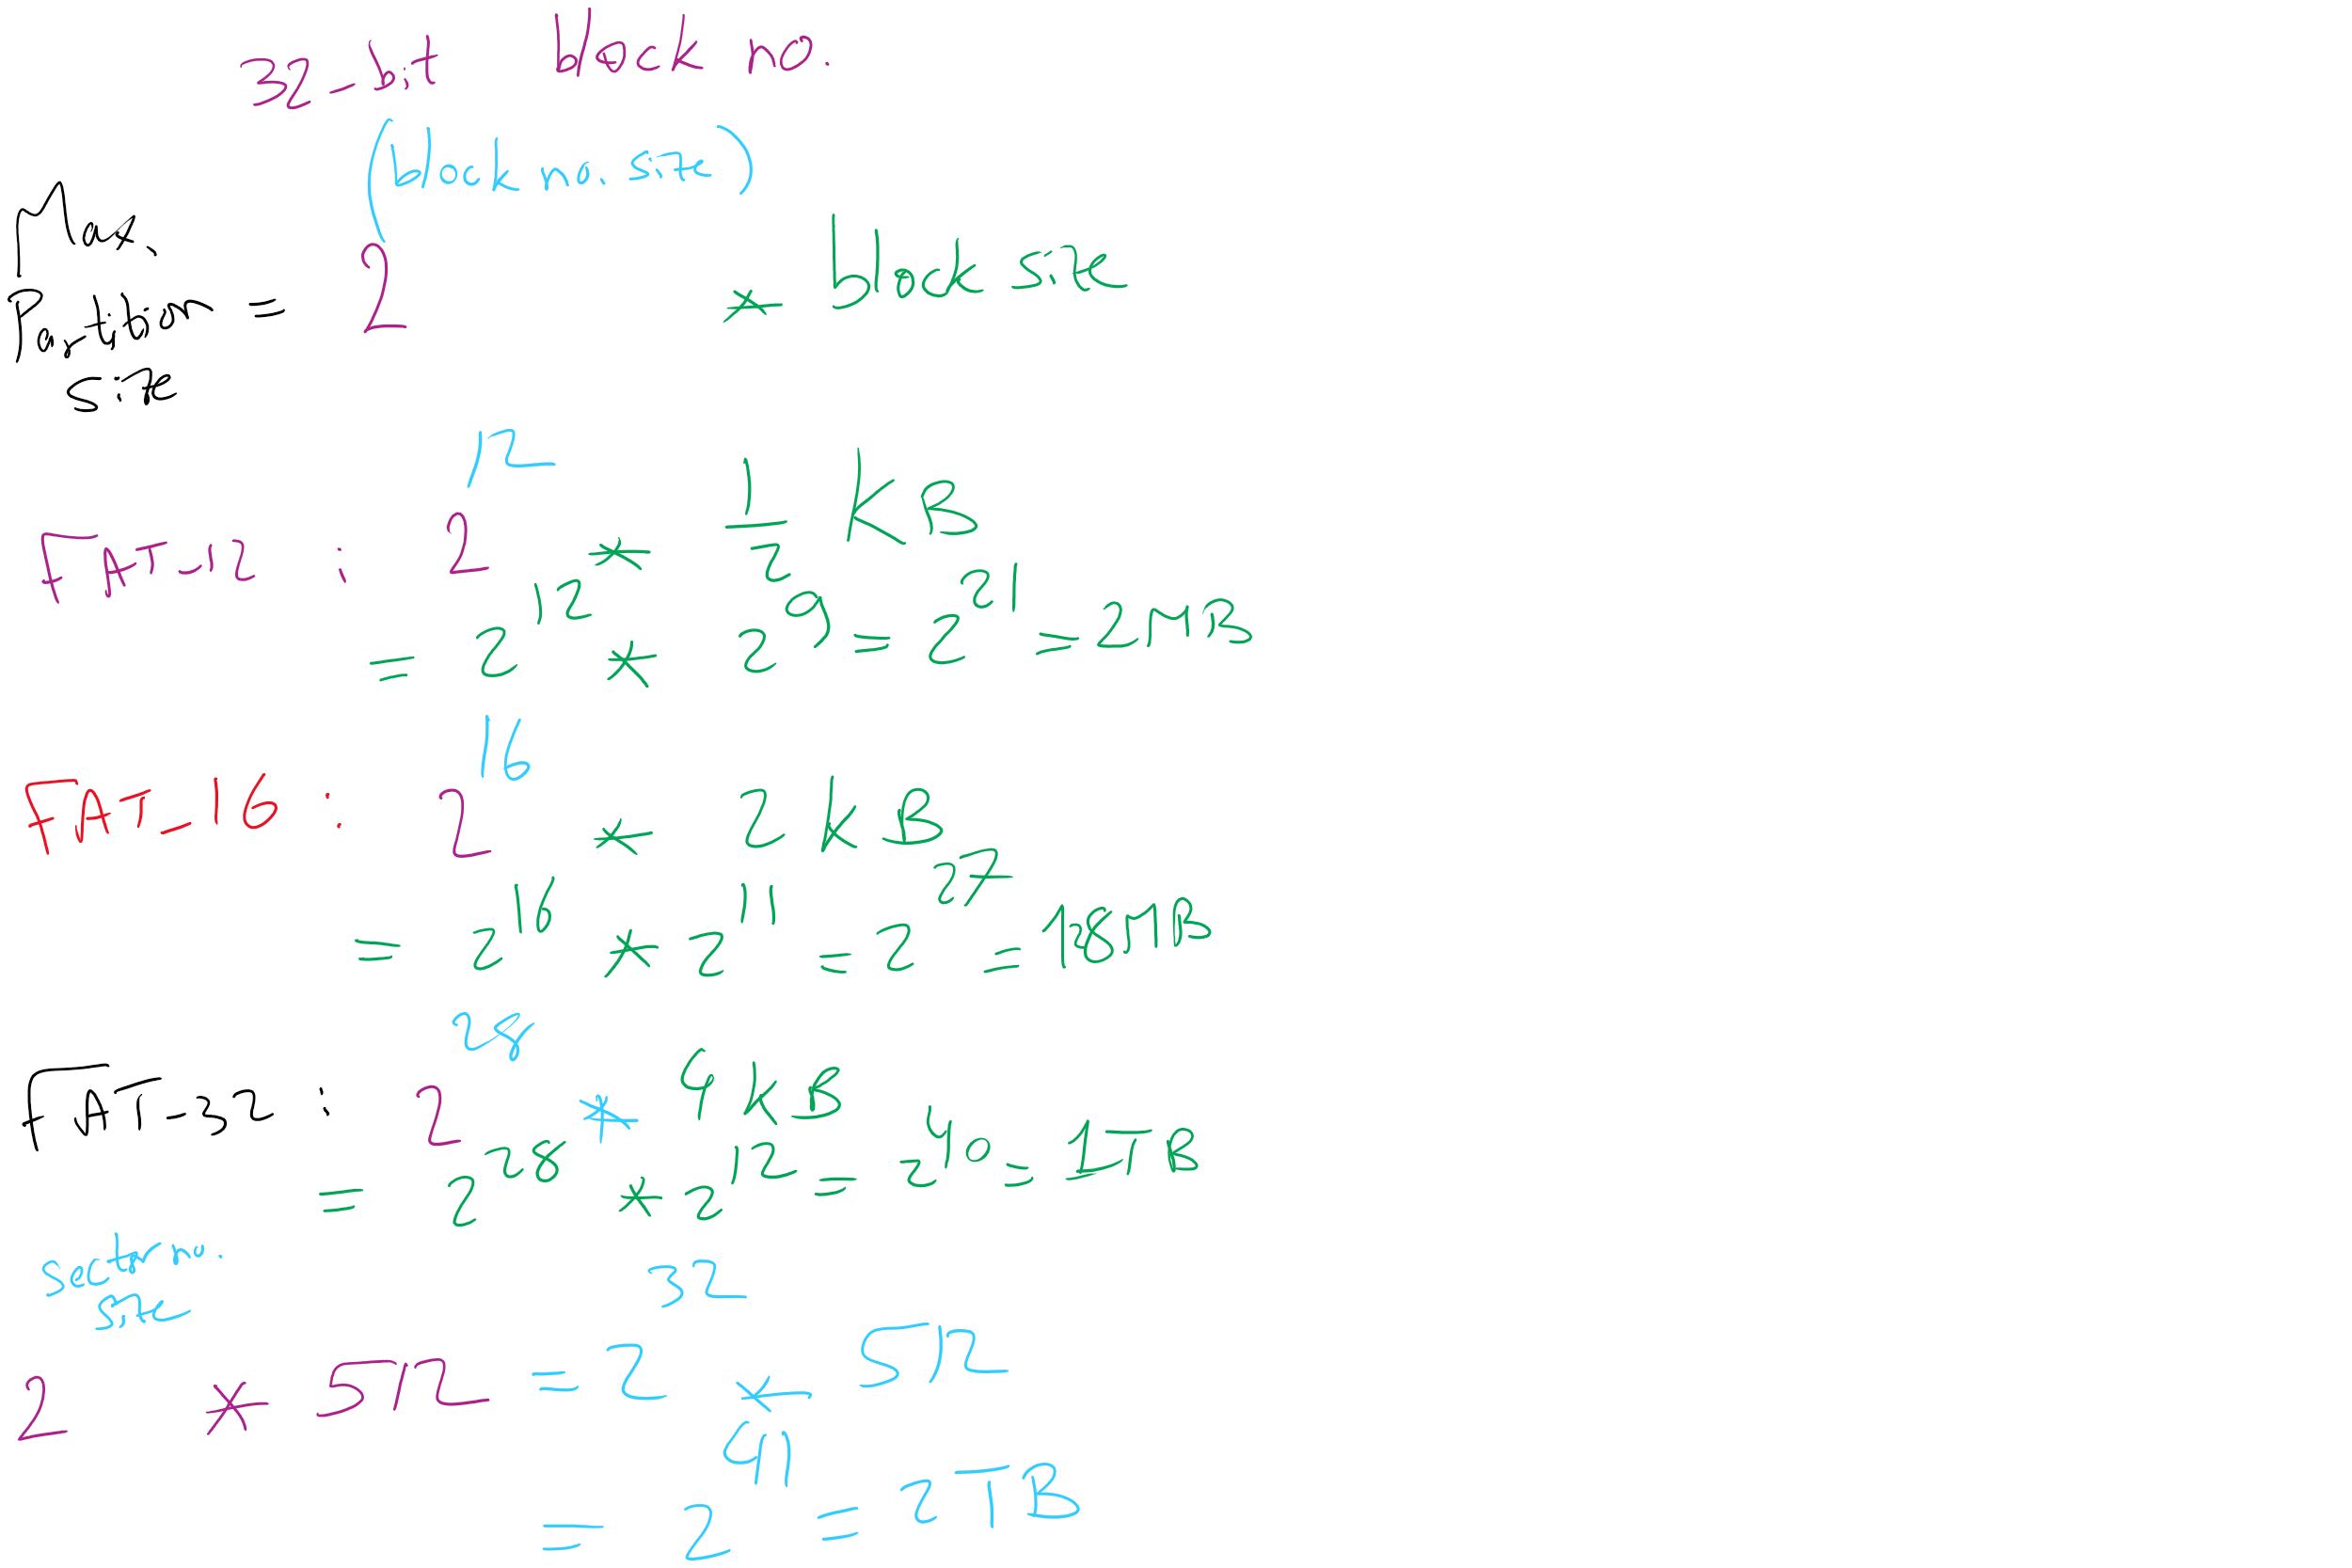
Max Partition Size

Slide 11
Max Partition Size

Slide 12
Max Partition Size
Block size | FAT-12 | FAT-16 | FAT-32
0.5 KB | 2 MB
1 KB | 4 MB
2 KB | 8 MB | 128 MB
4 KB | 16 MB | 256 MB | 1 TB
8 KB |  | 512 MB | 2 TB
16 KB |  | 1024 MB | 2 TB
32 KB |  | 2048 MB | 2 TB

Slide 13
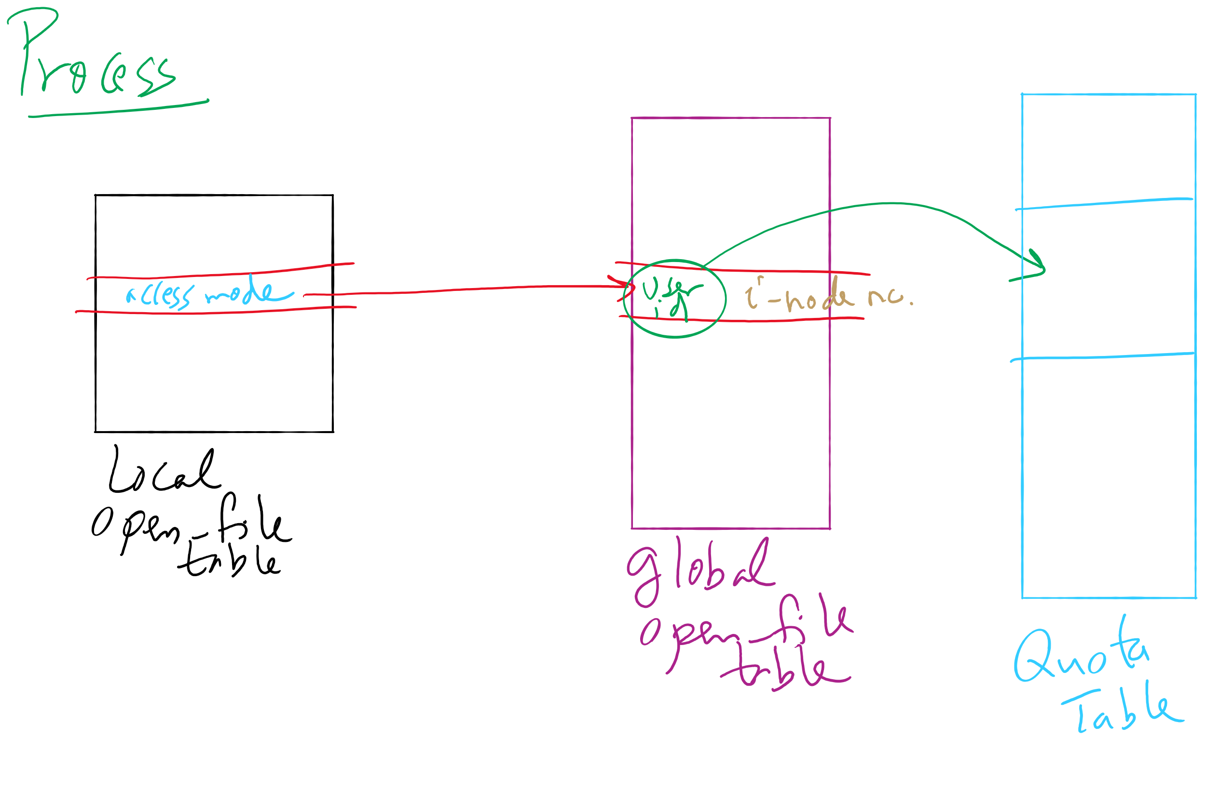
File-related kernel structures: open file tables and disk quotas

Slide 14
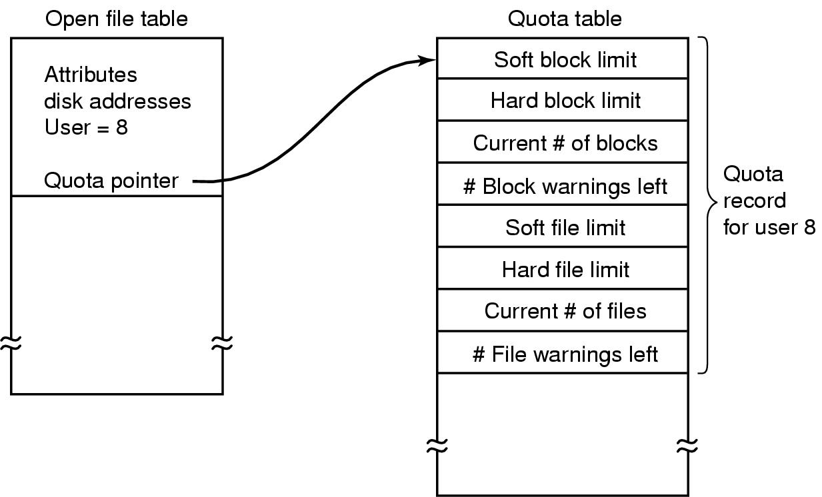
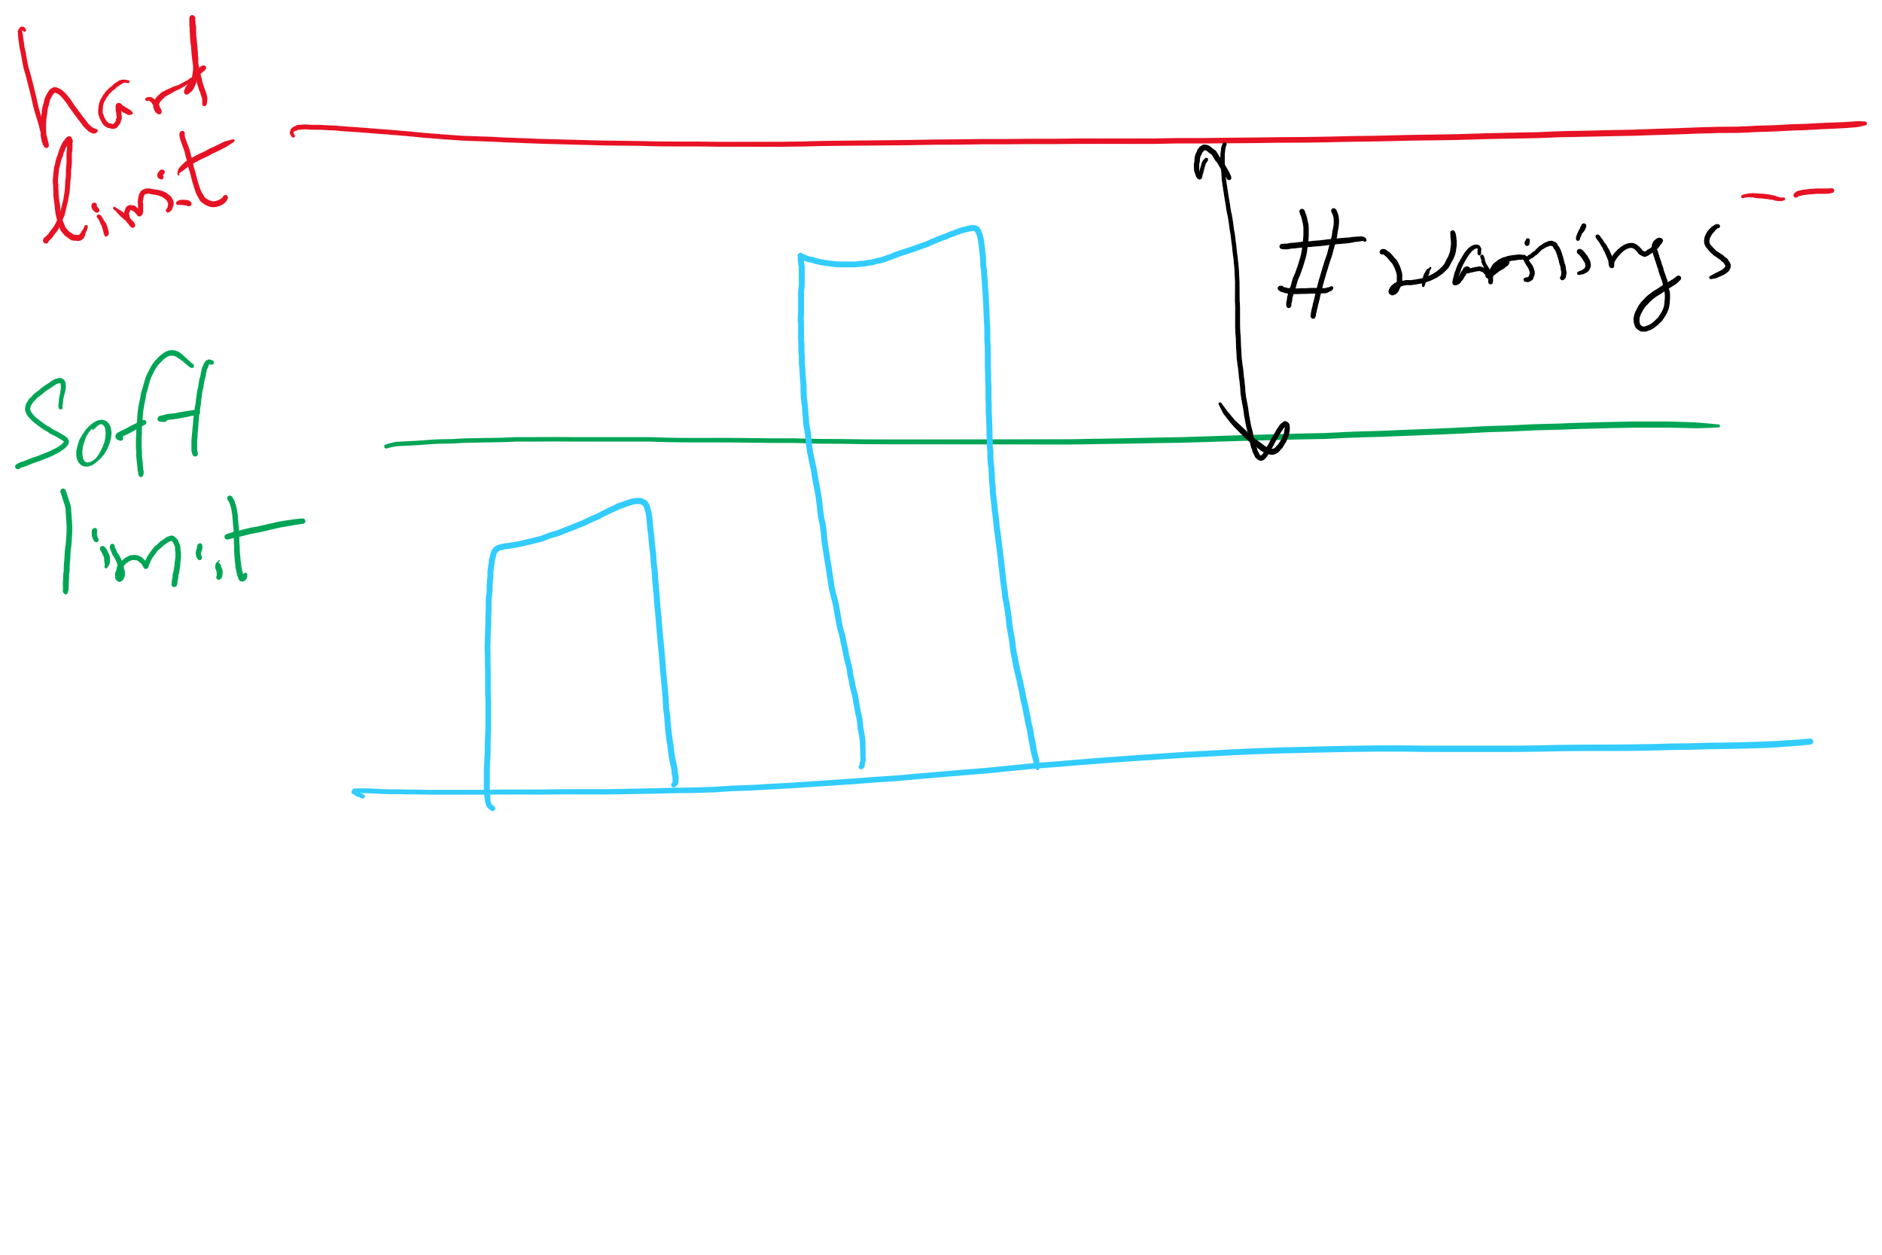
File-related kernel structures: open file tables and disk quotas

